Slide 1

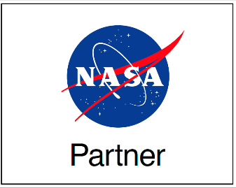

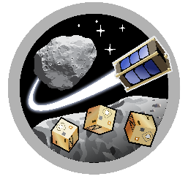
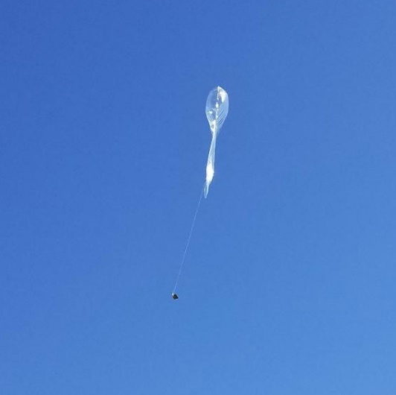
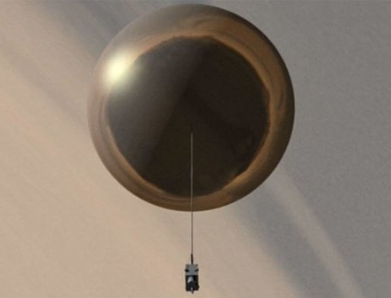
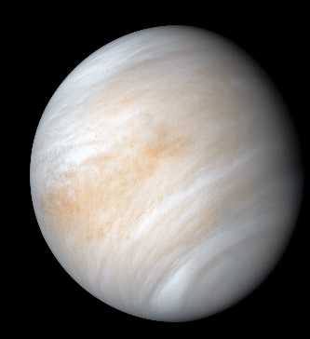
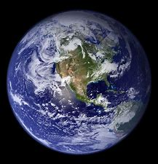
MIRO
Space Grant
ASTEROIDS
Pico Balloon Platform for Atmospheric Exploration
Josh Crest
Space and Terrestrial Robotic Exploration (SpaceTREx) Laboratory
Aerospace and Mechanical Engineering Department - University of Arizona
Arizona NASA Space Grant Symposium 4/17/21

Slide 2
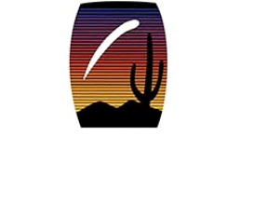
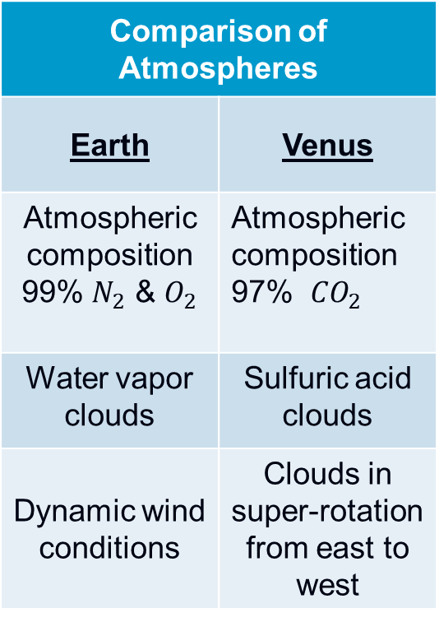
Motivation
Comparison of Atmospheres
Earth | Venus
Atmospheric composition 99% $N_{2}$ & $O_{2}$ | Atmospheric composition 97% ${CO}_{2}$
Water vapor clouds | Sulfuric acid clouds
Dynamic wind conditions | Clouds in super-rotation from east to west
NASA has expresses interest in revisiting Venus to perform life detection experiments
Challenges make current exploration costs high
Average surface temperature 450° C
Surface pressure ~90 atm
Sulfuric Acid Clouds

Slide 3
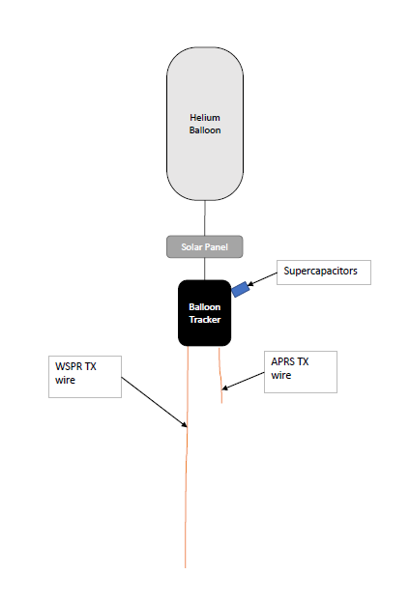
Objective
Develop a pico-balloon platform that can be used for atmospheric exploration
Balloons are the optimal exploration platform for Venus
Low-cost & low-risk missions

Slide 4
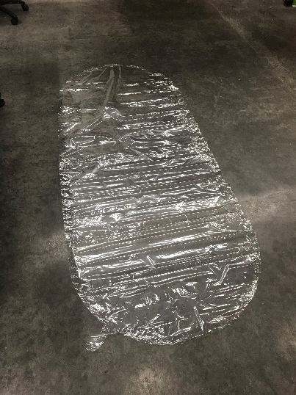
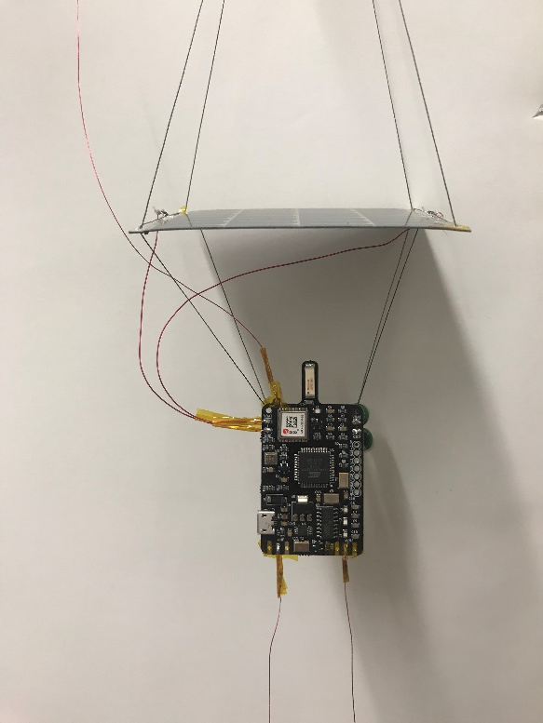
Prototype
Transmits via amateur radio
Relay's location, altitude, temperature, pressure, speed, and direction
LightAPRS-W balloon tracker
50cm APRS TX wire
5m WSPR ground wire & TX wire
SBS-13 Balloon envelope
2.5V 3.3F super capacitors x2
50 mA @ 4.8V Powerfilm solar panel
15 lb. fishing line
4
7
3
6
5
1
3
2
APRS: Automatic Packet Reporting System
WSPR: Weak Signal Propagation Reporter

Slide 5
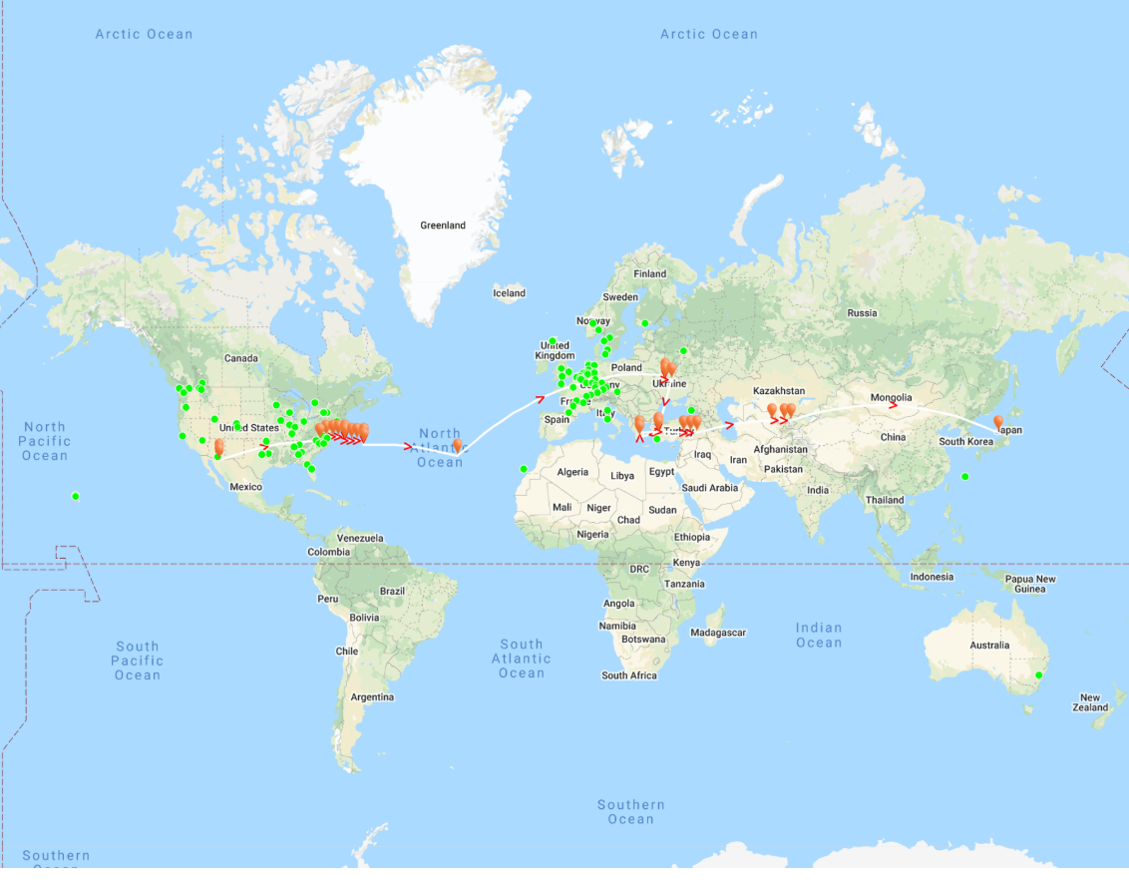
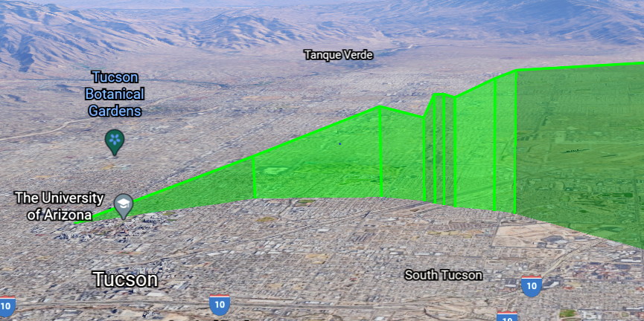
Flight 1
Total payload weight: 37.5 grams
6.5 grams free lift
Target altitude
35,000 - 40,000 ft.
247 hours flight time
Max speed 289 MPH

Slide 6
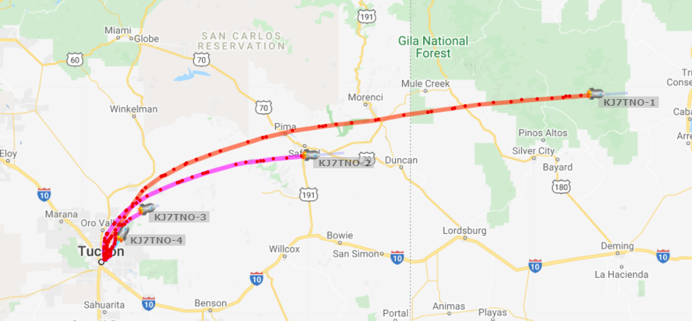
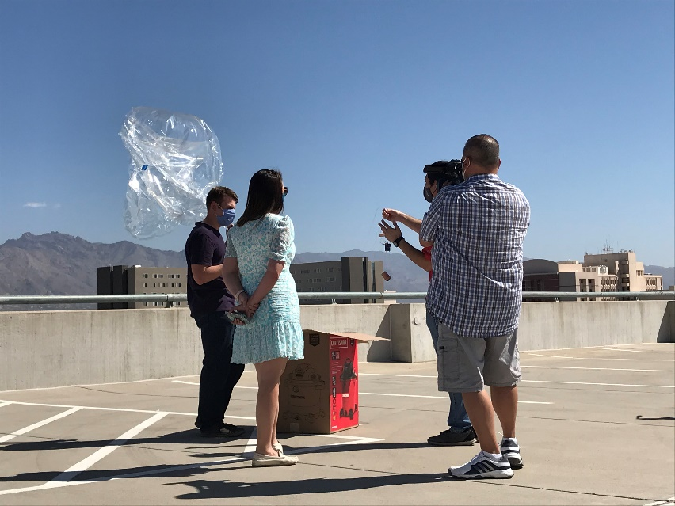
Flight 2
4 pico-balloons
Testing different balloon envelope materials (mylar and SBS-13)
6.5 grams free lift
Target altitude
35,000 - 40,000 ft.
In progress – 4/2/21

Slide 7

Conclusions
Successfully created a pico-balloon platform for terrestrial atmospheric exploration
In situ measurements of the jet streams
Can be expanded to fly on Venus
Swarms of pico-balloons could be launched to form a constellation around Venus.
Long duration in situ detectors identifying regions with the highest potential for life.

Slide 8
Acknowledgements
Jekan Thangavelautham - Mentor
Tristian Schuler – Graduate Student
Layne Crawford – Administrative Program Manager Asteroids laboratory
Michelle Coe – Manager, Arizona/NASA Space Grant Program
Michael Debbins – Undergraduate researcher

Slide 9
Thank you

Slide 10
References
Ford, Kevin. (1997). Optimizing Aerobot Exploration of Venus.
Limaye, Sanjay & Mogul, Rakesh & Smith, David & Ansari, Arif & Słowik, Grzegorz & Vaishampayan, Parag. (2018). Venus' Spectral Signatures and the Potential for Life in the Clouds. Astrobiology. 18. 10.1089/ast.2017.1783.
Greaves, Jane & Richards, Anita & Bains, William & Rimmer, Paul & Sagawa, Hideo & Clements, David & Seager, Sara & Petkowski, Janusz & Sousa-Silva, Clara & Ranjan, Sukrit & Drabek-Maunder, Emily & Fraser, Helen & Cartwright, Annabel & Mueller-Wodarg, Ingo & Zhan, Zhuchang & Friberg, Per & Coulson, Iain & Lee, E'lisa & Hoge, Jim. (2020). Phosphine Gas in the Cloud Decks of Venus.
11th Lighter-than-Air Systems Technology Conference, Clearwater, Florida, May 16, 1995
Lorenz, R. D., Crisp, D., & Huber, L. (2018). Venus atmospheric structure and dynamics from the VEGA lander and balloons: New results and PDS archive. ICARUS, 305, 277–283. https://doi-org.ezproxy2.library.arizona.edu/10.1016/j.icarus.2017.12.044

